Slide 1
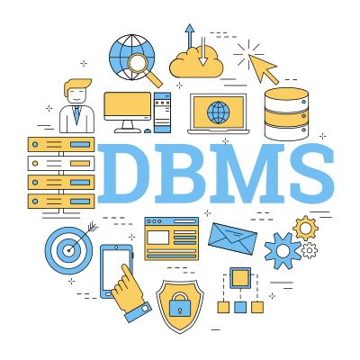
Database Systems Concepts and Design
CSC201S2/G2

Slide 2
Chapter 1: Introduction

Slide 3
Outline
Database-System Applications
Purpose of Database Systems
View of Data
Database Languages
Database Design
Database Engine
Database Architecture
Database Users and Administrators
History of Database Systems

Slide 4
Database Systems
DBMS contains information about a particular enterprise
Collection of interrelated data
Set of programs to access the data
An environment that is both convenient and efficient to use
Database systems are used to manage collections of data that are:
Highly valuable
Relatively large
Accessed by multiple users and applications, often at the same time.
A modern database system manage a large, complex collection of data.
Databases touch all aspects of our lives

Slide 5
Database Applications Examples
Enterprise Information
  Sales: customers, products, purchases
  Accounting: payments, receipts, assets
  Human Resources: Information about employees, salaries, payroll taxes.
Manufacturing: management of production, inventory, orders, supply chain.
Banking and finance
  customer information, accounts, loans, and banking transactions.
  Credit card transactions
  Finance: sales and purchases of financial instruments (e.g., stocks and bonds; storing real-time market data
Universities: registration, grades

Slide 6
Database Applications Examples
Airlines: reservations, schedules
Telecommunication: records of calls, texts, and data usage, generating monthly bills, maintaining balances on prepaid calling cards
Web-based services
  Online retailers: order tracking, customized recommendations
  Online advertisements
Document databases
Navigation systems: For maintaining the locations of varies places of interest along with the exact routes of roads, train systems, buses, etc.

Slide 7
Purpose of Database Systems
Data redundancy and inconsistency
Difficulty in accessing data
Data isolation
Integrity problems
  Integrity constraints (e.g., account balance > 0) become “buried” in program code rather than being stated explicitly
  Hard to add new constraints or change existing ones

Slide 8
Purpose of Database Systems
Atomicity of updates
  Failures may leave database in an inconsistent state with partial updates carried out
Concurrent access by multiple users
  Concurrent access needed for performance
  Uncontrolled concurrent accesses can lead to inconsistencies
Security problems
  Hard to provide user access to some, but not all, data

Slide 9
View of Data
A database system is a collection of interrelated data and a set of programs that allow users to access and modify these data.
A major purpose of a database system is to provide users with an abstract view of the data.
  Data models
    A collection of conceptual tools for describing data, data relationships, data semantics, and consistency constraints.
  Data abstraction
    Hide the complexity of data structures to represent data in the database from users through several levels of data abstraction.

Slide 10


Slide 11
Data Models
A collection of tools for describing
  Data
  Data relationships
  Data semantics
  Data constraints
Relational model
Entity-Relationship data model (mainly for database design)
Object-based data models (Object-oriented and Object-relational)
Semi-structured data model (XML)
Other older models:
  Network model
  Hierarchical model

Slide 12
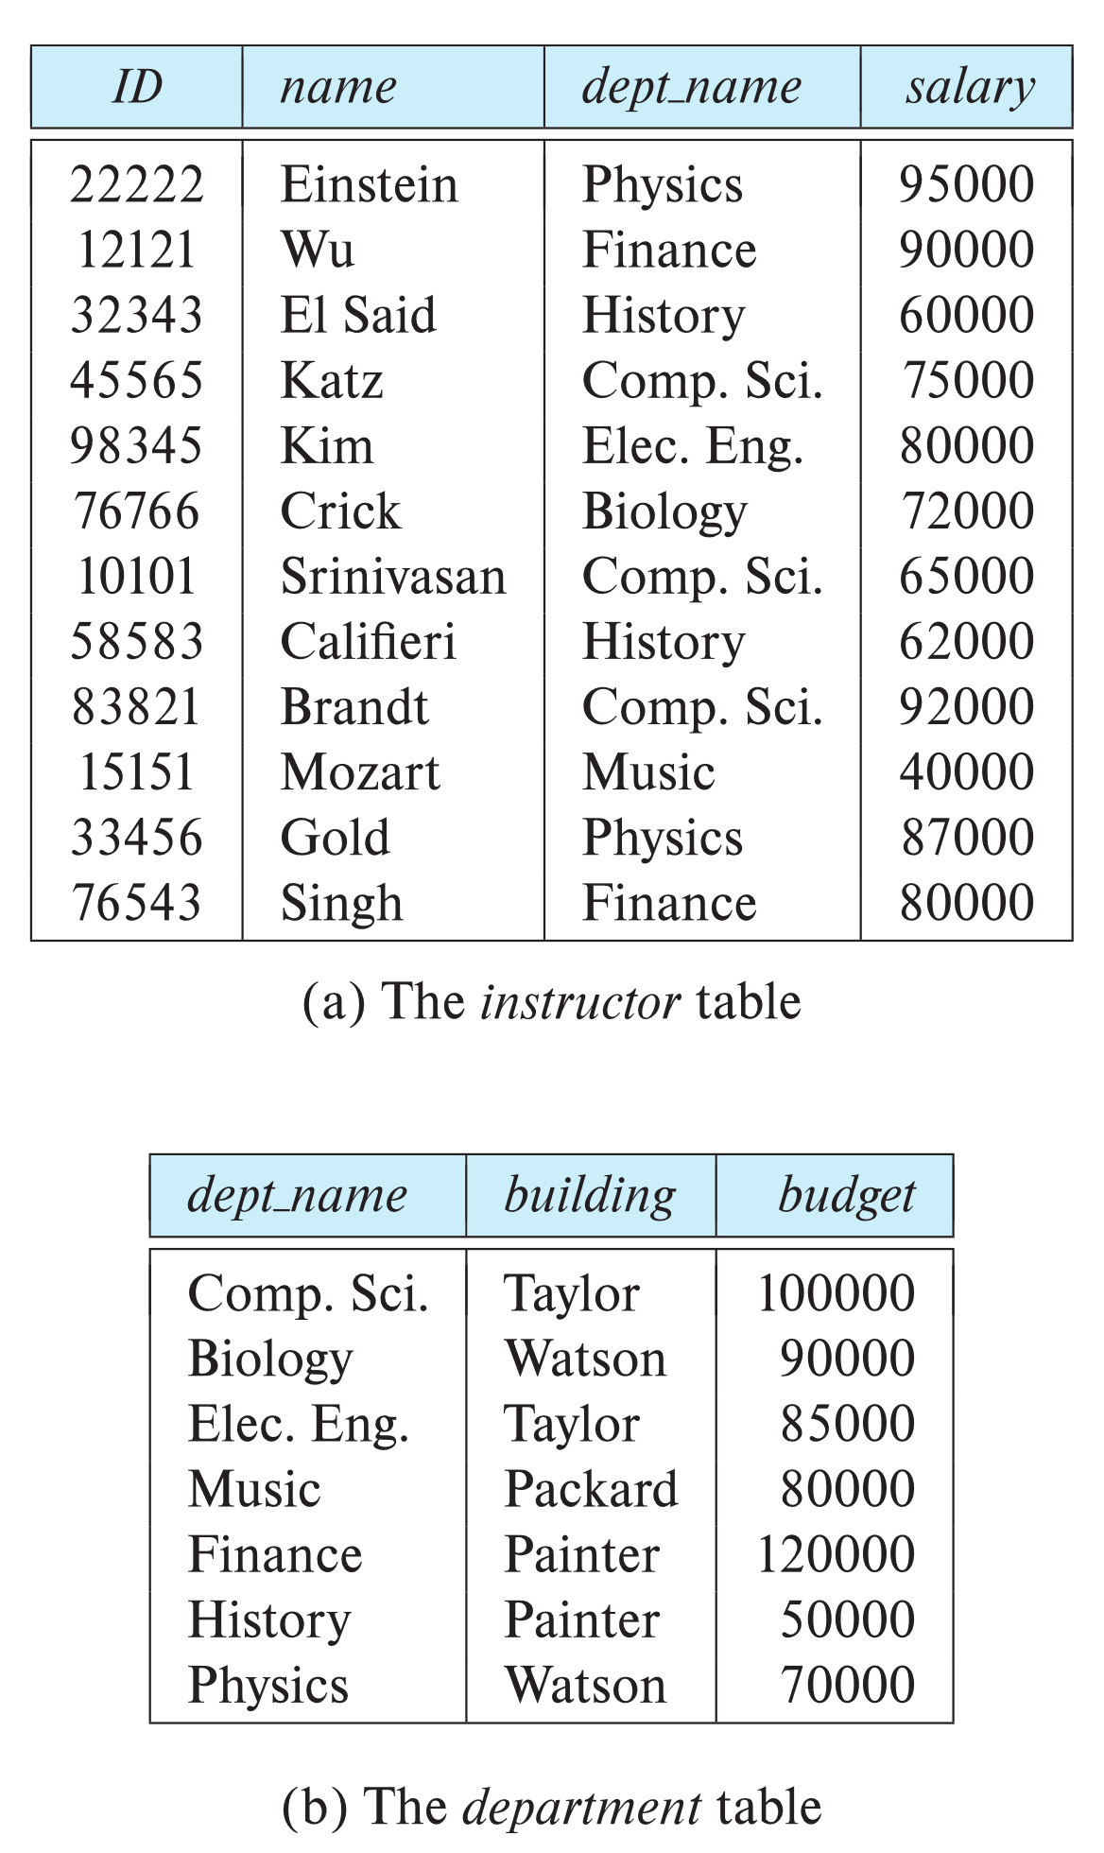

Relational Models
All the data is stored in various tables.
Example of tabular data in the relational model
Columns
Rows
Ted Codd
Turing Award 1981

Slide 13
Sample Relational Models

Slide 14
Levels of Abstraction
Physical level: describes how a record (e.g., instructor) is stored.
Logical level: describes data stored in database, and the relationships among the data.
  type instructor = record
  ID : string;
  name : string;
  dept_name : string;
  salary : integer;
        end;
View level: application programs hide details of data types. Views can also hide information (such as an employee’s salary) for security purposes.

Slide 15
View of the Data
An architecture for a database system

Slide 16
Instances and Schema
Similar to types and variables in programming languages
Logical Schema – the overall logical structure of the database
  Eg: The database consists of information about a set of customers and accounts in a bank and the relationship between them
Physical schema – the overall physical structure of the database
Instance – the actual content of the database at a particular point in time
  Analogous to the value of a variable

Slide 17
Physical Data Independence
The ability to modify the physical schema without changing the logical schema
Applications depend on the logical schema
In general, the interfaces between the various levels and components should be well defined so that changes in some parts do not seriously influence others.

Slide 18
Data Definition Language (DDL)
Specification notation for defining the database schema
        create table instructor (
            ID char(5),
            name varchar(20),
            dept_name varchar(20),
            salary numeric(8,2)
            )
DDL compiler generates a set of table templates stored in a data dictionary
Data dictionary contains metadata (i.e., data about data)
    Database schema
    Integrity constraints: Primary key
    Authorization

Slide 19
Data Manipulation Language (DML)
Language for accessing and updating the data organized by the appropriate data model
DML also known as query language
There are basically two types of data-manipulation language
  Procedural: require a user to specify what data are needed and how to get those data.
  Declarative: require a user to specify what data are needed without specifying how to get those data.
Declarative DMLs are usually easier to learn and use than are procedural DMLs.
Declarative DMLs are also referred to as non-procedural DMLs
The portion of a DML that involves information retrieval is called a query language.

Slide 20
SQL Query Language
SQL query language is nonprocedural.
Example to find all instructors in Comp. Sci. dept
        select name
        from instructor
        where dept_name = “Comp. Sci”
SQL is NOT a Turing machine equivalent language
Compute complex functions SQL is usually embedded in some higher-level language
Application programs generally access databases through one of
  Language extensions to allow embedded SQL
  Application program interface which allow SQL queries to be sent to a database

